Slide 1
Conceptual Dynamics
Part II: Particle Kinematics
Chapter 3
Kinematics of Particles
Plane Curvilinear Motion
n-t Coordinates

Slide 2
n-t Coordinate System

Slide 3
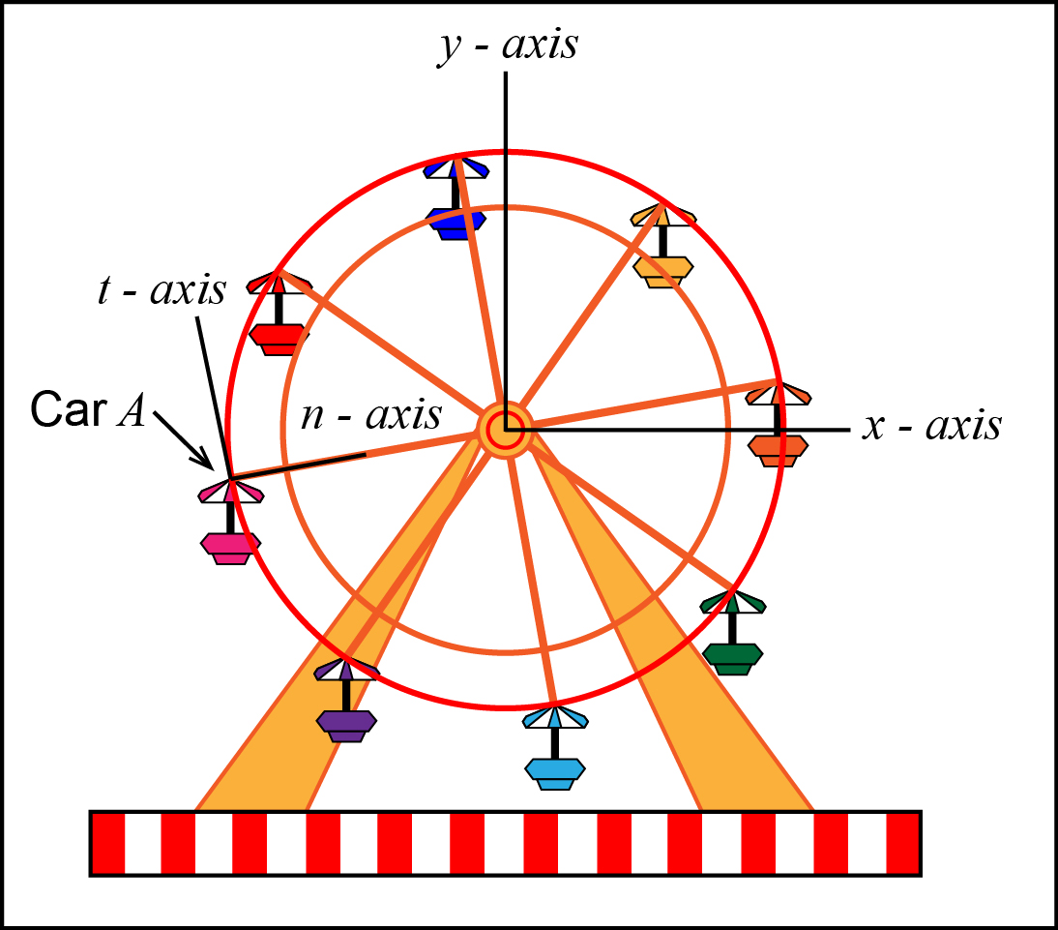
n-t coordinate system
Solving for the acceleration of Car A would be difficult using x-y coordinates.
x-y is good for straight line motion.

Slide 4
n-t coordinate system
n-t coordinates are more natural for curved paths that are known.

Slide 5
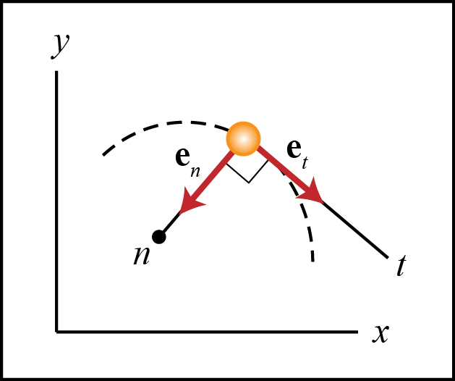
Normal & Tangential Coor. Sys.
Used when the path of the particle is known.
Body fixed coordinate frame
Attached to and moves with the particle.

Slide 6
Normal & Tangential Coor. Sys.

Slide 7
Normal & Tangential Coor. Sys.
t - axis: The positive t – axis is in the direction of motion, tangent to the path curve.

Slide 8
Normal & Tangential Coor. Sys.
n – axis: The positive n – axis is perpendicular to the t – axis and is directed toward the center of curvature.

Slide 9
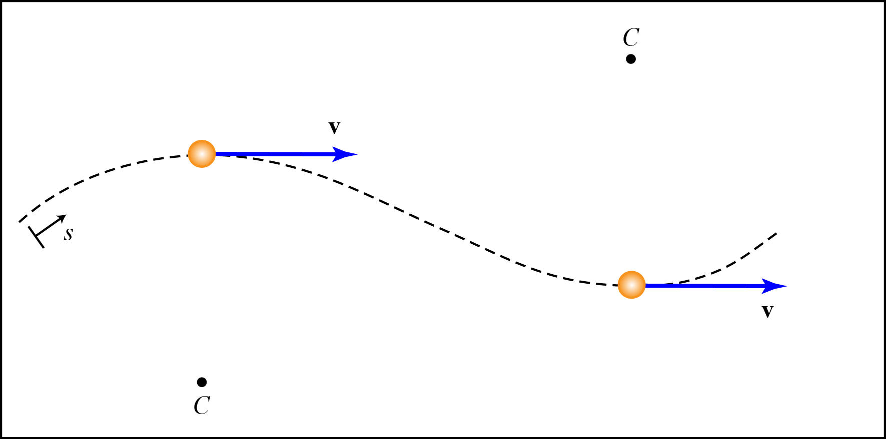
Example 3.3-1
Draw the n-t axes for the two particles.
C denotes the center of curvature.

Slide 10
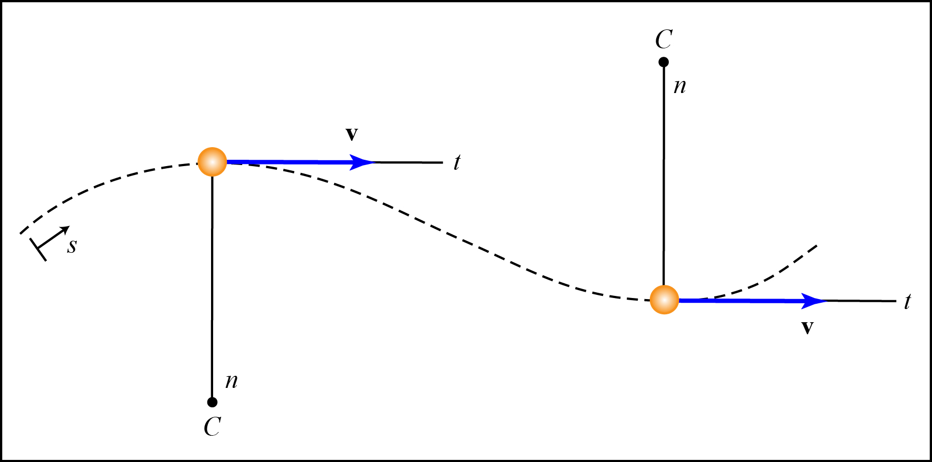
Example 3.3-1
Draw the n-t axes for the two particles.
C denotes the center of curvature.

Slide 11
Velocity

Slide 12
Velocity
Velocity is the time rate of change of position.
Velocity is always tangent to the path.
t-axis is always tangent to the path.

Slide 13
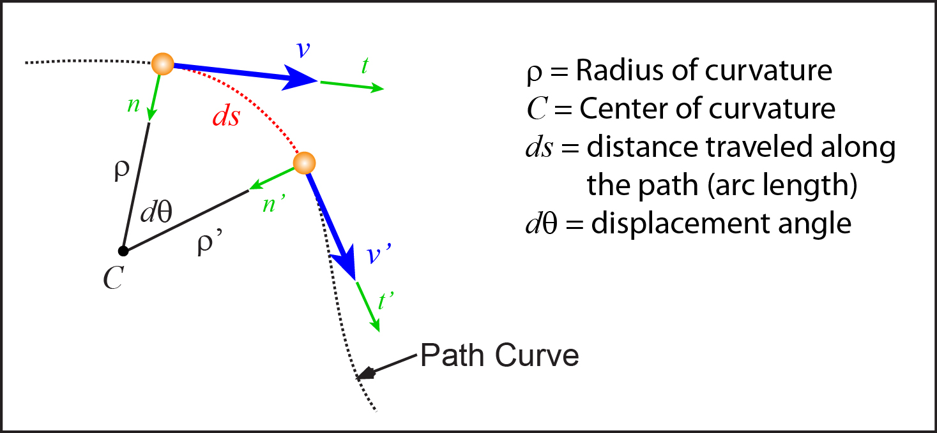
Example 3.3-2
Derive the following speed equation with the help of the figure.

Slide 14
Example 3.3-2
What is the general calculus equation for the velocity?

Slide 15
Example 3.3-2
What is the length of ds?

Slide 16
Example 3.3-2
Derive the velocity equation.

Slide 17
Example 3.3-2
Derive the velocity equation.

Slide 18
Acceleration

Slide 19
Acceleration
Acceleration: Time rate of change of velocity.
Use the product rule to take the derivative of the velocity.
Does like ?
No. The t – axis changes direction.

Slide 20
Acceleration
Acceleration: Time rate of change of velocity.
This is not a very useful form of the acceleration equation. We need to find out what equals.

Slide 21
Acceleration
We need to know both the magnitude and direction of

Slide 22
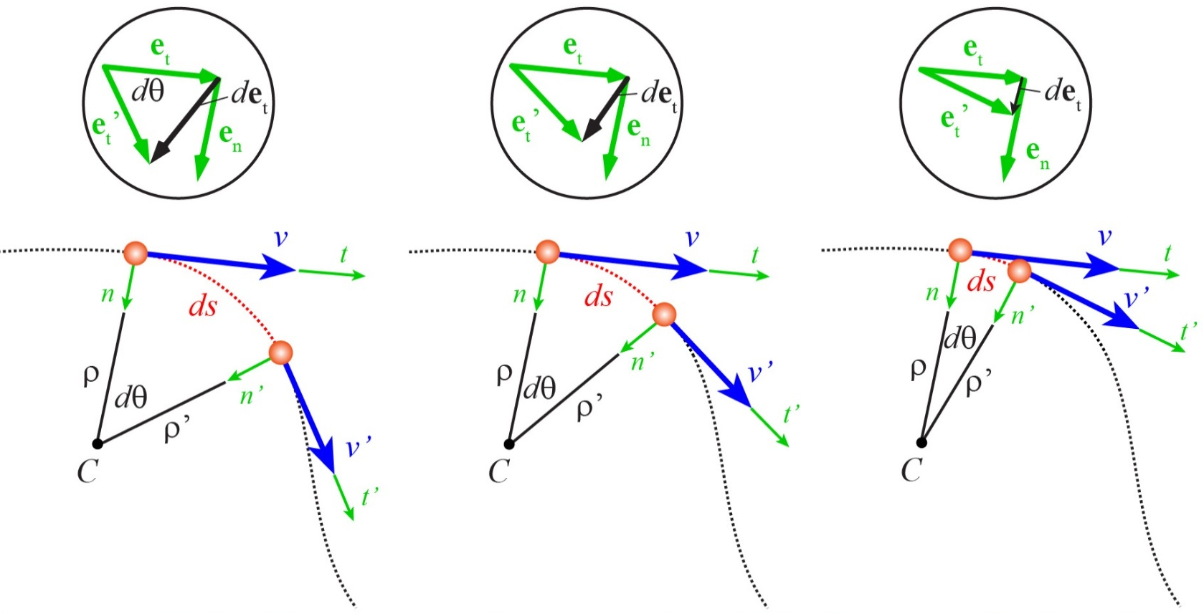
Acceleration
Direction of de_{t} /dt : As ds becomes smaller and smaller, will begin to point in what direction?

Slide 23
Acceleration
Direction of de_{t} /dt : As ds becomes smaller and smaller, will begin to point in what direction?

Slide 24
Acceleration
Magnitude of : When ds becomes infinitesimally small, can be estimated by the arc length between and .
What is the magnitude
of ?

Slide 25
Acceleration
Magnitude of : When ds becomes infinitesimally small, can be estimated by the arc length between and .
What is the magnitude
of ?
dθ

Slide 26
Acceleration
Take the time derivative of both sides.

Slide 27
Acceleration
Use the velocity equation to determine the value of ?

Slide 28
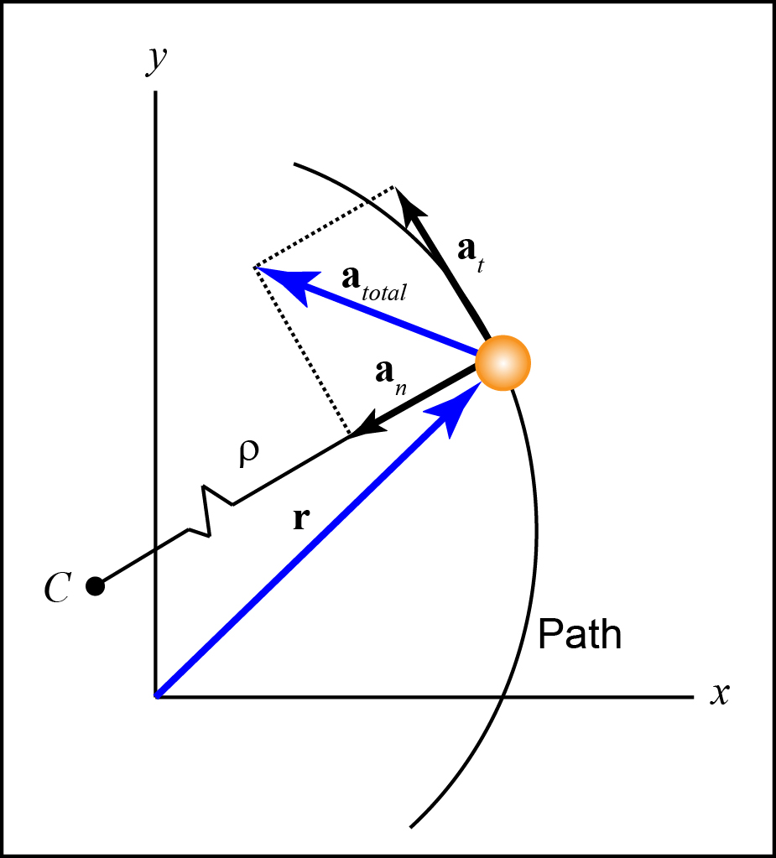
Acceleration

Slide 29
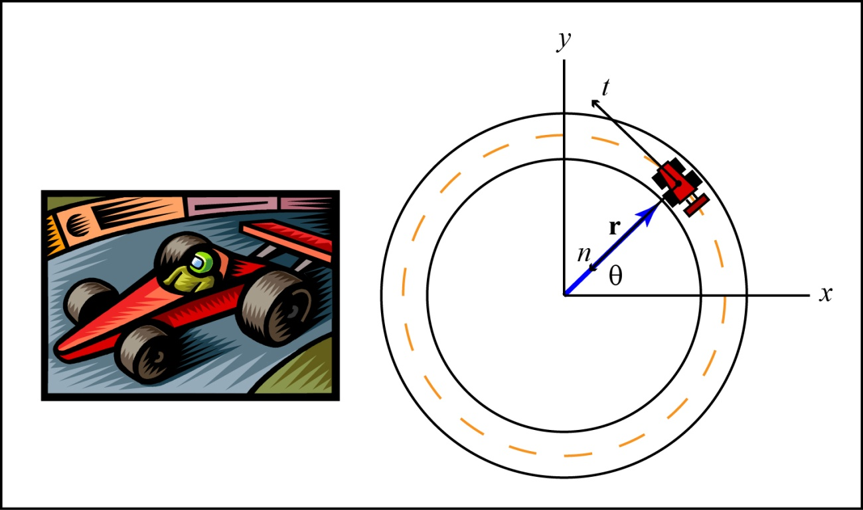
Acceleration
A particle’s acceleration is always nonzero if the particle is moving on a curve, even if its speed is constant. Why?

Slide 30
Acceleration
A particle’s acceleration is always nonzero if the particle is moving on a curve, even if its speed is constant. Why?
Velocity changes
direction.
A constant speed
only means that
a_{t} = 0.

Slide 31
Acceleration
What does represent in the above equation?

Slide 32
Acceleration
What does represent in the above equation?
The increase in speed.
Car: Stepping on the gas pedal.

Slide 33
Acceleration
What does represent in the above equation?

Slide 34
Acceleration
What does represent in the above equation?
Acceleration due to a change in direction.
Car: Turning the steering wheel.

Slide 35
Important Equations
Used if the path curve is a
given function ( f (x) )

Slide 36
Circular Motion

Slide 37
Circular Motion
Consider a car that travels around a circular test track of radius r.

Slide 38
Circular Motion
The n-t coordinate velocity and acceleration equations are given.
What remains constant when considering circular motion?

Slide 39
Circular Motion
The radius is constant (ρ = r).

Slide 40
Circular Motion
We can rearrange these equation further.

Slide 41
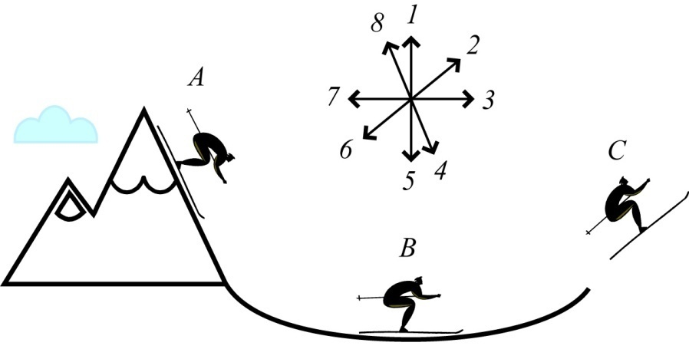
Conceptual Example 3.3-3
Consider the ski jumper shown in the figure. Neglect surface friction and air resistance. Determine the direction of the velocity and acceleration of the skier at position A, B and C. Use the arrow diagram to describe the direction.

Slide 42
Conceptual Example 3.3-3
What direction is the acceleration of the skier at position A, B and C.

Slide 43
Conceptual Example 3.3-3
What direction is the acceleration of the skier at position A, B and C.
A

Slide 44
Conceptual Example 3.3-3
What direction is the acceleration of the skier at position A, B and C.
B
A

Slide 45
Conceptual Example 3.3-3
What direction is the acceleration of the skier at position A, B and C.
B
C
A

Slide 46
Conceptual Example 3.3-4
Consider a ball moving at 5 m/s, but in the following situations represented in the figure. Rank the situations in order of largest to smallest ball acceleration magnitude for the instant represented in the figure.

Slide 47
Conceptual Example 3.3-4
Largest
Next
Next
Next
Next
Smallest

Slide 48
Conceptual Example 3.3-4
Largest
Next
Next
Next
Next
Smallest
F
a = 9.81 m/s²
a = 0 m/s²
a = <9.81 m/s²
a = <9.81 m/s²
E
A
D, C
a = 25 m/s²
a = 27 m/s²
B

Slide 49
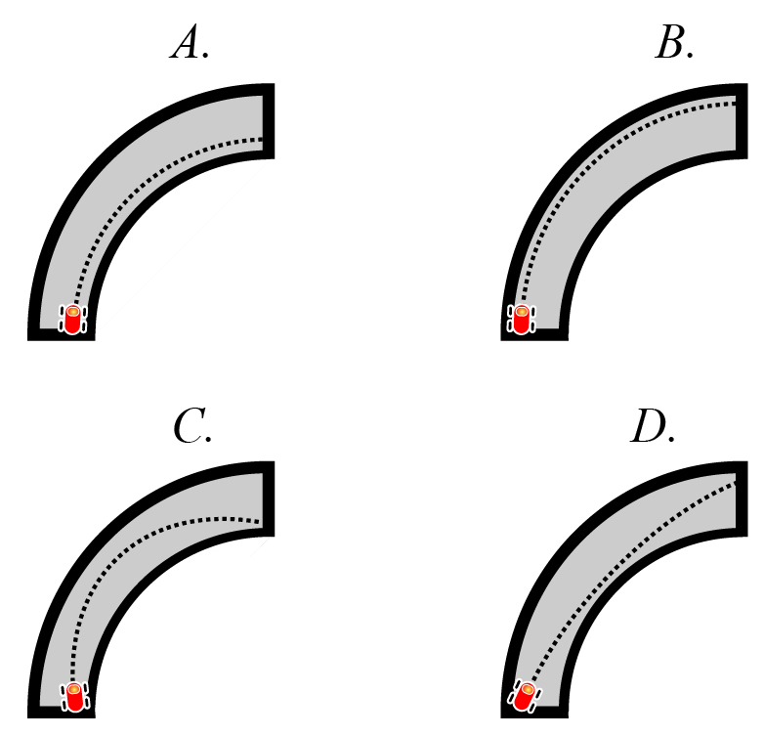
Conceptual Example 3.3-5
It is known that the total amount of acceleration that a racecar tire can achieve before skidding is limited. Therefore, which of the following paths should a racecar driver take through a curve in order to maximize the amount of speed that she can carry through the curve?

Slide 50
Conceptual Example 3.3-5
Which of the following paths should a racecar driver take through a curve in order to maximize the amount of speed that she can carry through the curve?

Slide 51
Conceptual Example 3.3-5
Which of the following paths should a racecar driver take through a curve in order to maximize the amount of speed that she can carry through the curve?

Slide 52
Example Problems
EP3.3-6
EP3.3-7 (Video)
EP3.3-8
EP3.3-9

